Slide 1
Lecture # 07 Amdahl’s Law
Parallel and Distributed Computing
CS-482

Slide 2
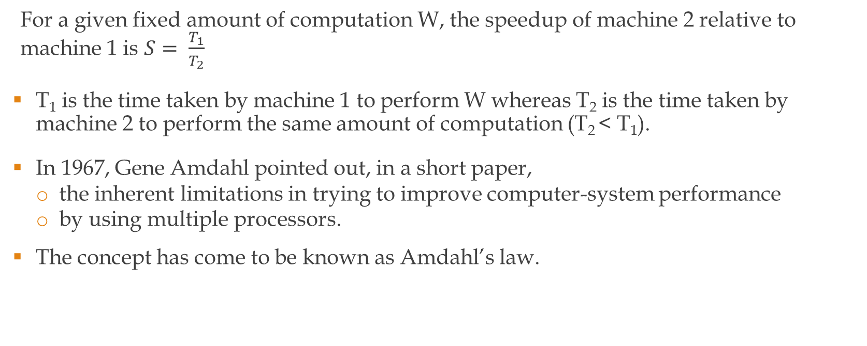
Amdahl’s law
For a given fixed amount of computation W, the speedup of machine 2 relative to machine 1 is $S= \frac{T_{1}}{T_{2}}$
T₁ is the time taken by machine 1 to perform W whereas T₂ is the time taken by machine 2 to perform the same amount of computation (T₂ < T₁).
In 1967, Gene Amdahl pointed out, in a short paper,
the inherent limitations in trying to improve computer-system performance
by using multiple processors.
The concept has come to be known as Amdahl’s law.

Slide 3

Amdahl’s law
Amdahl’s argument is essentially that
the overall performance improvement observed in an application program
(with fixed amount of computation W)
is limited by that portion of the application
that is unaffected by whatever change was made to the system.

Slide 4
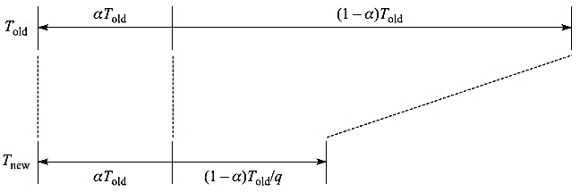
Amdahl’s law
Consider the execution time lines shown in fig 2.
The top line shows the time, T_{old}, required to execute some program P on the system before any changes are made.
Now assume that some change is made to the system that reduces execution time for some operations by a factor of q.
The program now runs in time T_{new}, where T_{new} < T_{old}, as shown in the bottom line.

Slide 5
Amdahl’s law
Hence there are many other operations in the program that are unaffected by this change.
Let α be the fraction of all operations that are unaffected by the enhancement.
Then, as shown in the bottom line of fig 2, the new execution time, T_{new}, can be divided into two components.

Slide 6
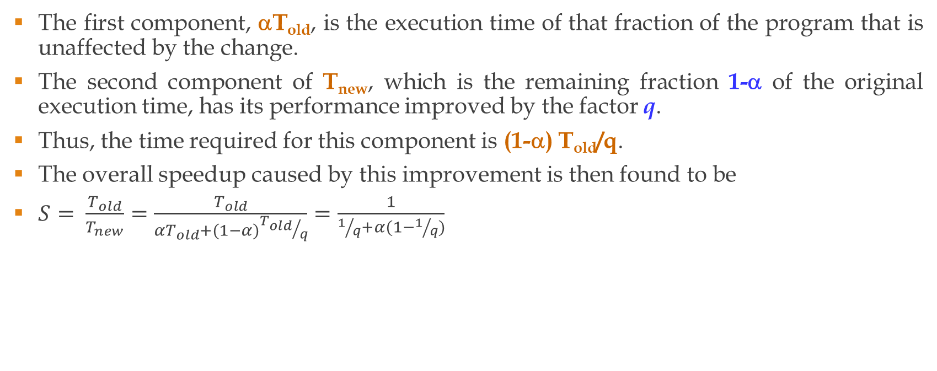
Amdahl’s law
The first component, αT_{old}, is the execution time of that fraction of the program that is unaffected by the change.
The second component of T_{new}, which is the remaining fraction 1-α of the original execution time, has its performance improved by the factor q.
Thus, the time required for this component is (1-α) T_{old}/q.
The overall speedup caused by this improvement is then found to be
$S= \frac{T_{old}}{T_{new}}=\frac{T_{old}}{{αT}_{old}+(1−α){T_{old}}/q}=\frac{1}{1/q+α(1−1/q)}$

Slide 7
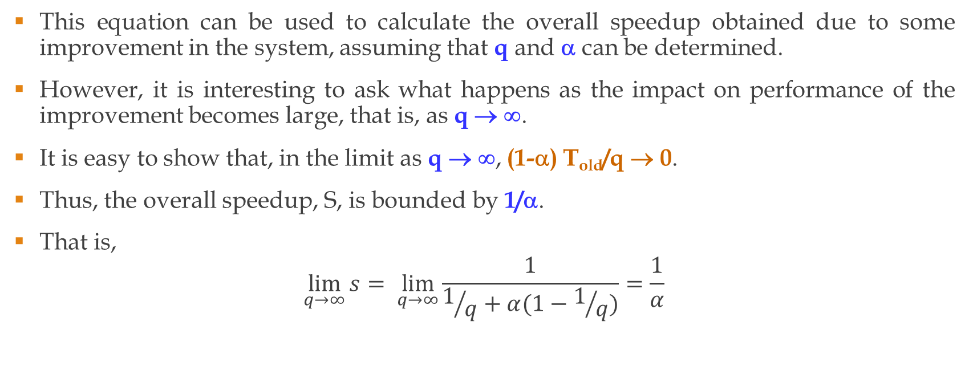
Amdahl’s law
This equation can be used to calculate the overall speedup obtained due to some improvement in the system, assuming that q and α can be determined.
However, it is interesting to ask what happens as the impact on performance of the improvement becomes large, that is, as q → ∞.
It is easy to show that, in the limit as q → ∞, (1-α) T_{old}/q → 0.
Thus, the overall speedup, S, is bounded by 1/α.
That is,
$$\lim_{q→∞}{s}= \lim_{q→∞}{\frac{1}{1/q+α(1−1/q)}}=\frac{1}{α}$$

Slide 8
Amdahl’s law
This result says that, no matter how much one type of operation in a system is improved,
the overall performance is inherently limited by the operations that are unaffected by the improvement.
For example, the best speedup that could be obtained in a parallel computing system with p processors is p.
However, if 10% of a program cannot be executed in parallel, the overall speedup when using the parallel machine is at most 1/α = 1/0.1=10, even if an infinite number of processors were available.

Slide 9
Amdahl’s law
An obvious corollary to Amdahl's law
any system designer or programmer should concentrate on making the common case fast.
That is, operations that occur most often will have the largest value of α.
Thus, improving these operations will have the biggest impact on overall performance.
Interestingly, the common cases also tend to be the simplest cases.
As a result, optimizing these cases first tends to be easier than optimizing the more complex, but rarely used, cases.

Slide 10
Scaling Amdahl’s law
One of the major criticisms concerning Amdahl’s law has been that it emphasizes the wrong aspect of the performance potential of parallel-computing systems.
The argument is that purchasers of parallel systems want to solve larger problems within the available time.
Following this line of argument leads to the following “scaled” or “fixed-time” version of Amdahl's law.
It is common to judge the performance of an application executing on a parallel system by
comparing the parallel execution time with p processors, T_{p},
with the time required to execute the equivalent sequential version of the application program, T₁,
using the speedup S_{p} = T₁/T_{p}.

Slide 11
Scaling Amdahl’s law
With the fixed-time interpretation, however, the assumption is that
there is no single-processor system that is capable of executing an equivalent sequential version of the parallel application.
The single-processor may not have a large enough memory, for example, or
the time required to execute the sequential version would be unreasonably long.

Slide 12
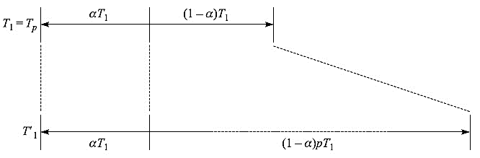
Scaling Amdahl’s law
In this case, the parallel-execution time is divided into
the parallel component, 1-α, and
the inherently sequential component, α, giving
T_{p} = αT₁ + (1-α)T₁ as shown in fig 3 below.
T₁ is the time in which user wants to run application.
Since no single-processor system exists that is capable of executing an equivalent problem of this size,
it is assumed that the parallel portion of the execution time would increase by a factor of p
if it were executed on a hypothetical single-processor system.

Slide 13

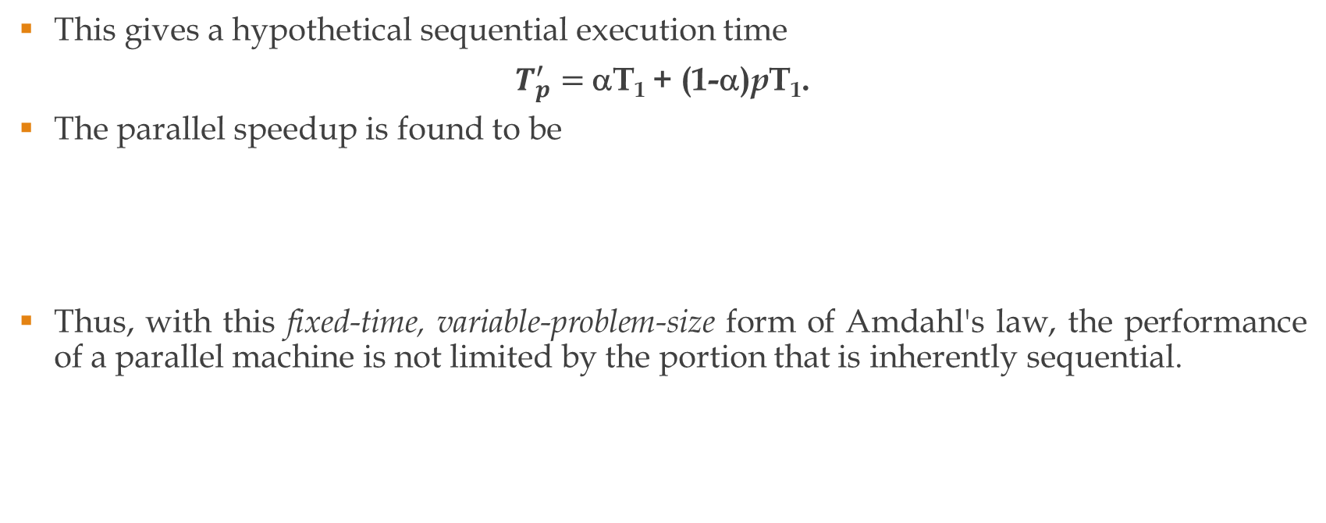
Scaling Amdahl’s law
This gives a hypothetical sequential execution time
$T_{p}^{′}=$αT₁ + (1-α)pT₁.
The parallel speedup is found to be
Thus, with this fixed-time, variable-problem-size form of Amdahl's law, the performance of a parallel machine is not limited by the portion that is inherently sequential.

Slide 14
Homework 1
An industrial process simulation involves five steps which are performed sequentially on system A. The steps 1 and 2 take 1 and 2 minutes respectively whereas steps 3 – 5 take 3 minutes each. Then system A was enhanced by introducing some parallelism to get a system B. The steps 3 to 5 on B now can be executed in parallel so that they take an overall time of 4 minutes whereas steps 1 and 2 are still to be executed in sequence. Calculate speedup using appropriate form of Amdahl’s law.

Slide 15
Homework 2
An industrial process simulation is to be executed on a system in the available time, t_{a}, of 10 min which includes parallel execution time (on 10 processors) of 7.5 min. It has been estimated that the parallel portion of the execution time would increase by a factor of 12 if it were executed on a hypothetical single-processor system. Calculate the parallel speedup.

Slide 16
Homework 3
In designing a new computer system, we make an enhancement that improves some mode of execution by a factor of 10. This enhancement takes 50% of the time when the enhanced mode is in use. (Recall that Amdahl’s law uses the fraction of the original, unenhanced execution time to find speedup)
What is the speedup that we have obtained by using this fast mode?
What percentage of the original execution time has been converted to fast mode?

